Slide 1
Databases project: Magic The Gathering
Robert Anderson, Kyle sarre, Gabriel Davis

Slide 2
MOtivations
Magic the Gathering (MtG), is a very popular trading card game.
Estimated 20 million players world-wide play MtG.
Printed in 100 different languages and played competitively
Prize pools reaching approximately $250,000
MtG has many cards which allows for a large diversity of deck compositions.
We wanted to analyze decks used in the competitive scene to identify trends in the cards used.
We believed that this data could be useful to MtG players looking to construct effective decks.
Magic the gathering, or MtG, is a popular trading card game owned by Wizards of the Coast, LLC. An estimated 20 million players play MtG around the world. MtG has been printed in 11 different languages and is played competitively, with prize pools reaching around $250,000. Wizards of the Coast sponsors a considerable number of these tournaments.

Slide 3
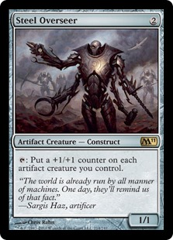
Application Domain
We identified four primary entities of interest for our database:
- cards
- competitions
- card representation (an existing deck/card combination),
-card usage (an instance of a player using a deck/card combination in actual play).
The following list elaborates on the attributes of our entities:
• Cards(card name, type, mana cost, white, blue, black, red, green, card description)
• Competitions(competition name, year)
• Card Representation(card name, deck name, copies of card)
• Usage(card name, deck name, competition name, year)

Slide 4
APPLICATION DOMAIN CONT.
List of assumptions made about the domain:
• Cards may have multiple types and multiple subtypes
o example: | Steel Overseer (card name) | Artifact creature (multiple type) – construct (subtype) |
• For card representation, deck names incorporate the deck user’s name and the deck name itself
Important constraints on entity attributes:
• For cards, mana cost must be a non-negative number or null
• A usage must have a corresponding card representation
• Copies of card should be positive
It should be noted that Usage and Card Representation entities are weak entities (uses a foreign key as part of its primary key).

Slide 5
ER-DIAGRAM
Card Representation
card name varchar(255)
deck name varchar(255)
copies of card int
Cards
card name varchar(255)
Type varchar(255)
mana cost int
white tinyint
Blue tinyint
Black tinyint
Red tinyint
Green tinyint
card description varchar(255)
Are given by
1…*
1…*
0…* 1…*
requires
Is seen/used at
0…* 1…*
Competitions
competition name varchar(255)
Year int
Usage
card name varchar(255)
deck name varchar(255)
competition name varchar(255)
Year int
requires
1…* 1…*

Slide 6
Database Design
Cards is in 4BNF because the only dependency is between the primary attribute card name and the rest of the non-primary attributes.
Competitions is in 4BNF because all its attributes are primary attributes (the same can be said of the Usage relation).
Card Representation is in 4BNF because its only non-primary attribute “copies of card” has no dependencies on any other non-primary attribute.
Hence the database is in 4BNF.

Slide 7
Data Collection
Data was collected from the official website of Wizards of the Coast, on a page containing the decklists of the top 8 decks of the 2017 Grand Prix tournament series (top 12 decks of the Team Grand Prix in San Antonio)
http://magic.wizards.com/en/articles/winning-decks
Data was parsed into MySQL-readable form by a custom Java program, and loaded into the database via a shell script.
The Java program utilized an open-source API to retrieve information about each card, found at http://magicthegathering.io.

Slide 8
Our database queries

Slide 9
All exclusively black and green cards
SELECT *
FROM cards
WHERE card.black = 1 and
card.green = 1 and
card.white = 0 and
card.red = 0 and
card.blue = 0 and
card.type NOT LIKE "%LAND%"

Slide 10
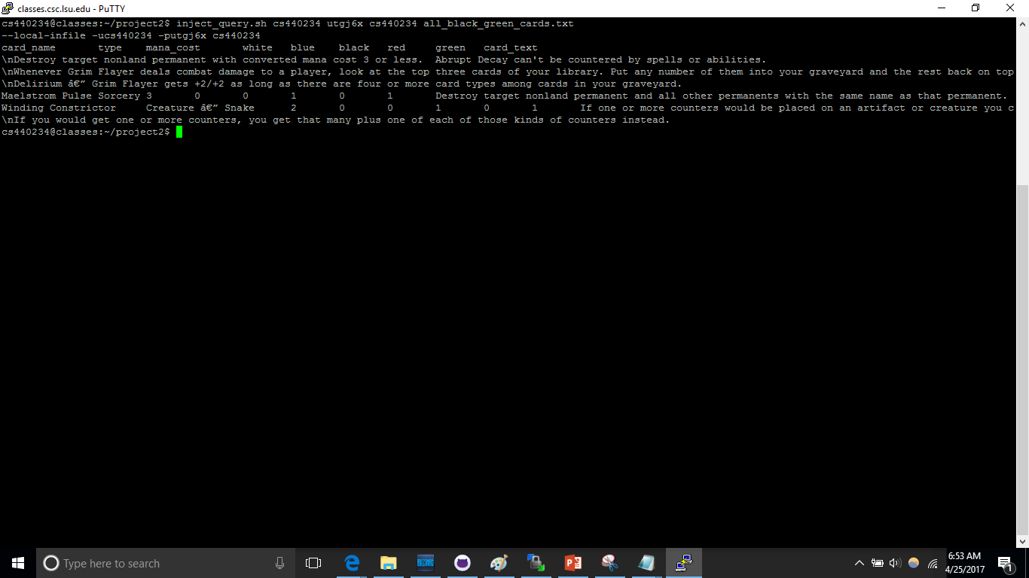
Result

Slide 11
All land cards

Slide 12
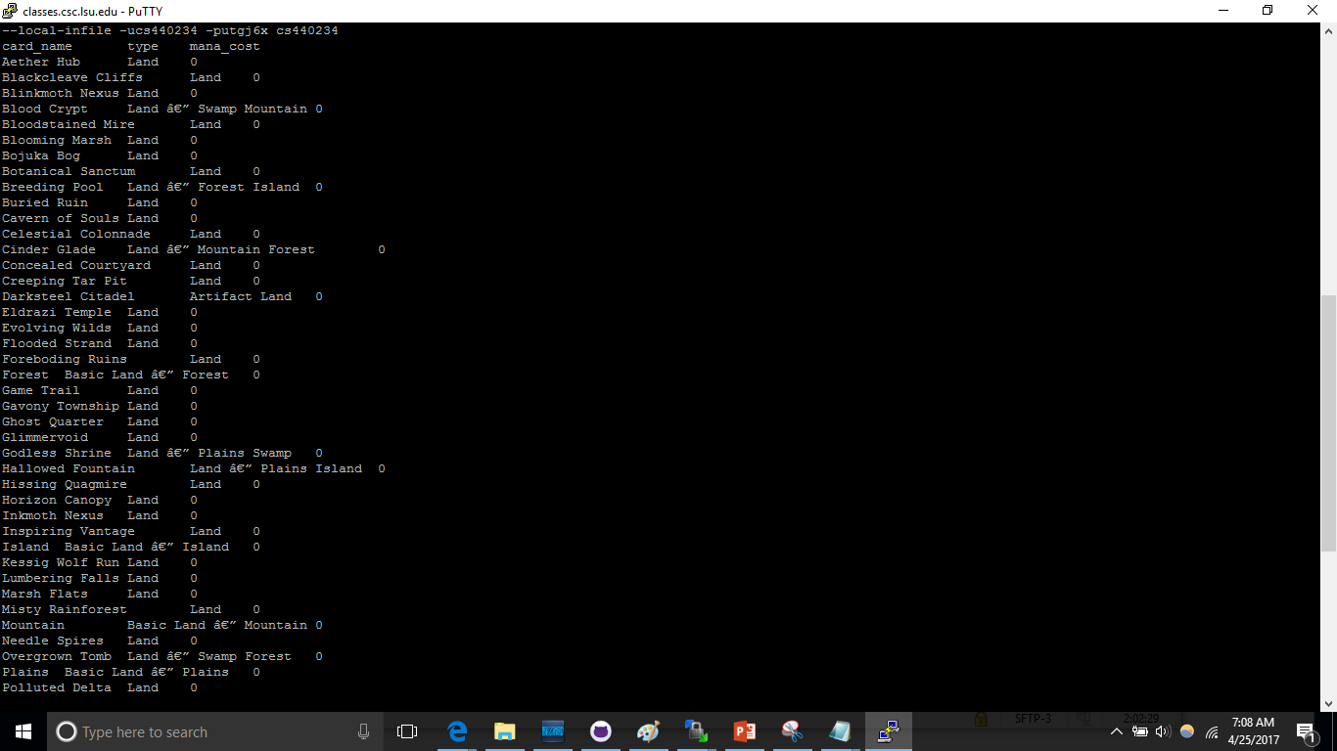

Slide 13
Most popular cards
SELECT card_name, COUNT(card_name) as num_of_decks_using_this_card
FROM card_representation as r
GROUP BY card_name
ORDER BY num_of_decks_using_this_card DESC

Slide 14
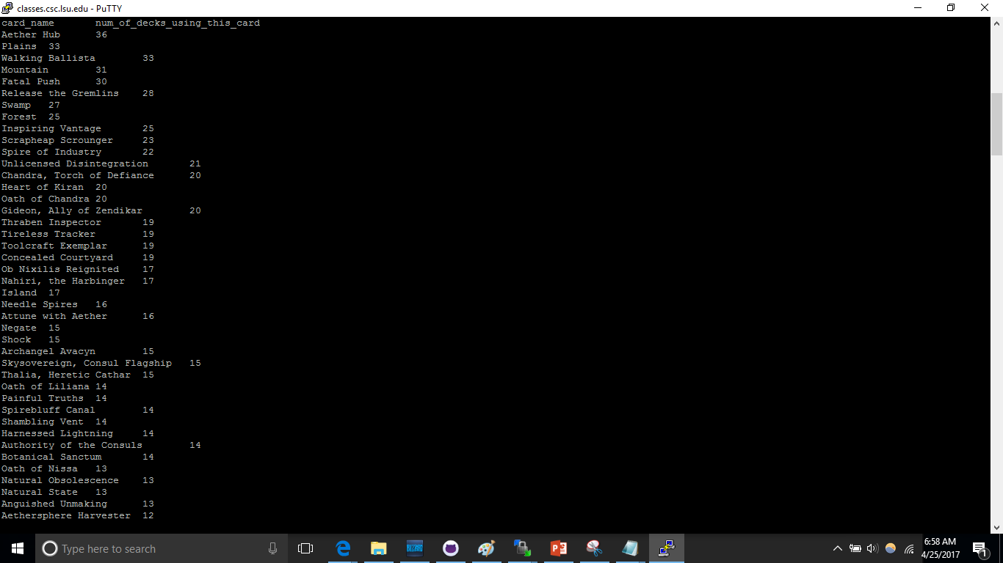

Slide 15
Popular 2-4 mana cards
SELECT u.card_name, COUNT(u.card_name) as num_of_decks_using_this_card
FROM card_representation as u, cards as c
WHERE u.card_name = c.card_name and c.mana_cost >= 0 AND c.mana_cost <= 2 AND c.type NOT LIKE "%Land%"
GROUP BY u.card_name
ORDER BY num_of_decks_using_this_card DESC

Slide 16
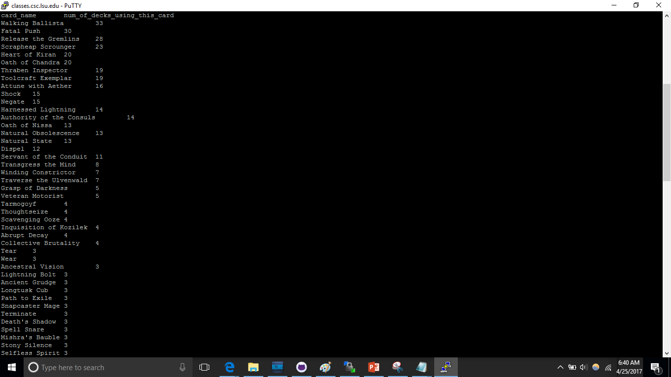
result

Slide 17
Red cards used more than 10 times
SELECT c.card_name, COUNT(u.card_name) as num_of_decks_using_this_card
FROM cards AS c, card_usage AS u
WHERE c.red = 1 AND c.card_name = u.card_name
GROUP BY u.card_name
HAVING num_of_uses >= 10
ORDER BY num_of_uses DESC;

Slide 18
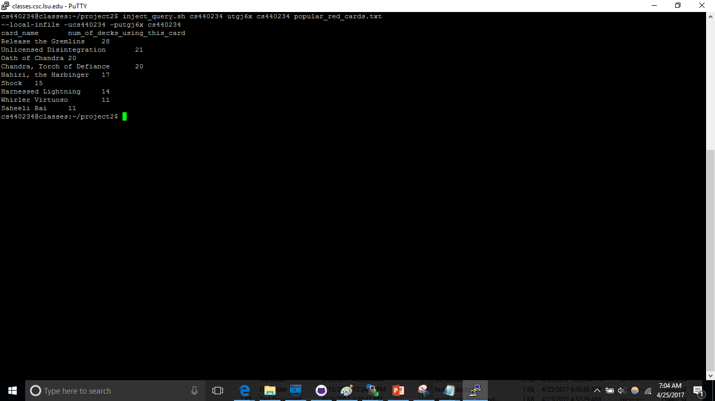

Slide 19
Most popular legendary cards
SELECT c.*, COUNT(u.deck_name) as num_of_appearances
FROM cards AS c, card_usage AS u
WHERE c.type LIKE "%Legend%"
GROUP BY c.card_name
ORDER BY num_of_appearances

Slide 20
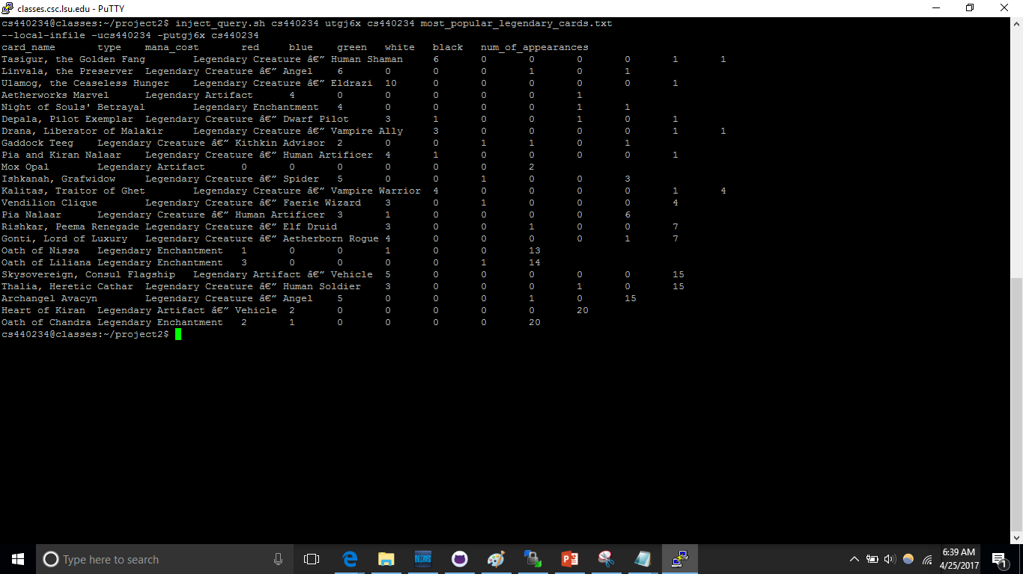
result

Slide 21
The most aggressive decks
SELECT AVG(card_name.c) as %_of_cards_below_2_mana
FROM cards as c, deck_representation as r
WHERE mana_cost.c IS NOT NULL AND mana_cost.c <= 2 AND r.card_name = c.card_name
GROUP BY deck_name.r
HAVING %_of_cards_below_2_mana >= .6
ORDER BY %_of_cards_below_2_mana ASC

Slide 22
result

Slide 23
Tournaments with the highest variance in cards used
SELECT competition_name, count(competition_name) as unique_cards
FROM (
SELECT competition_name, COUNT(card_name) as total_cards
FROM card_usage
GROUP BY card_name, competition_name
) AS x
GROUP BY competition_name
ORDER BY unique_cards DESC;

Slide 24
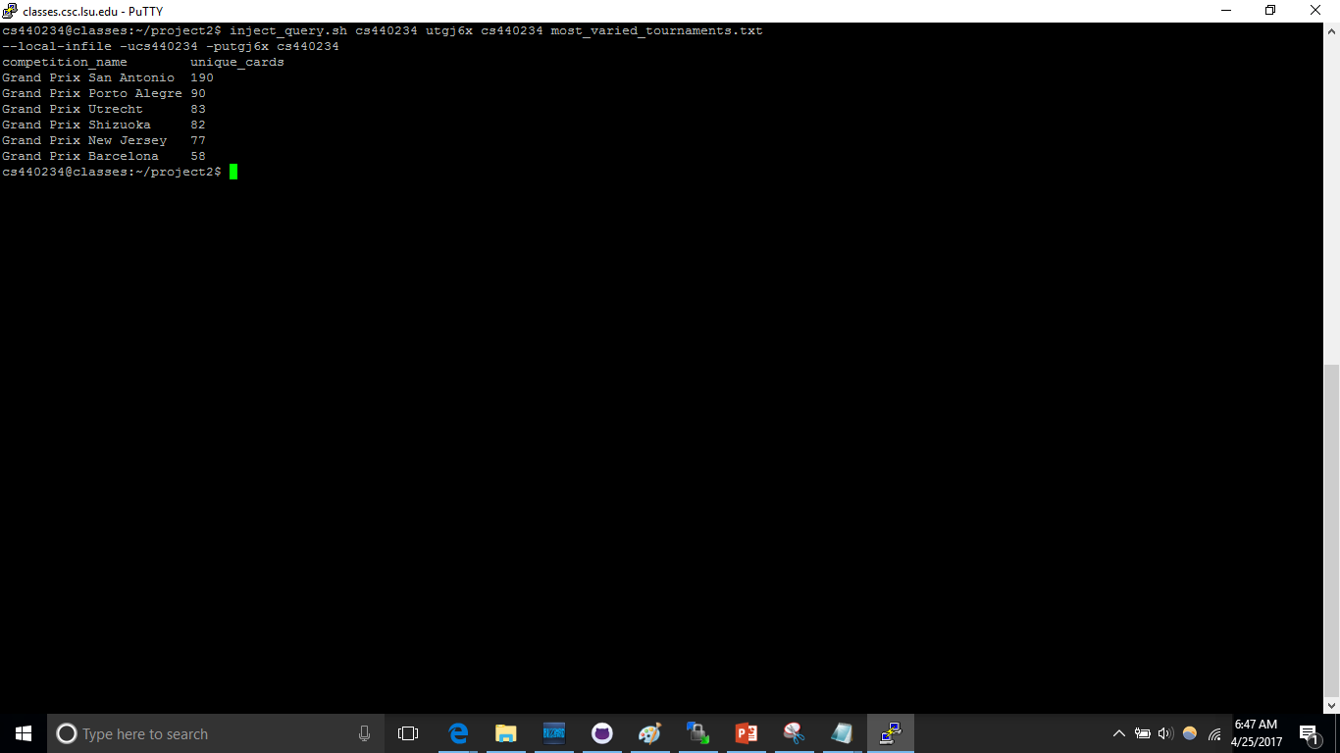
result

Slide 25
My time to shine (Cards unique to their tournament)
SELECT competition_name, count(competition_name) as unique_cards
FROM (
SELECT competition_name, COUNT(card_name) as total_cards
FROM card_usage
GROUP BY card_name, competition_name
) AS x
GROUP BY competition_name
ORDER BY unique_cards DESC;

Slide 26
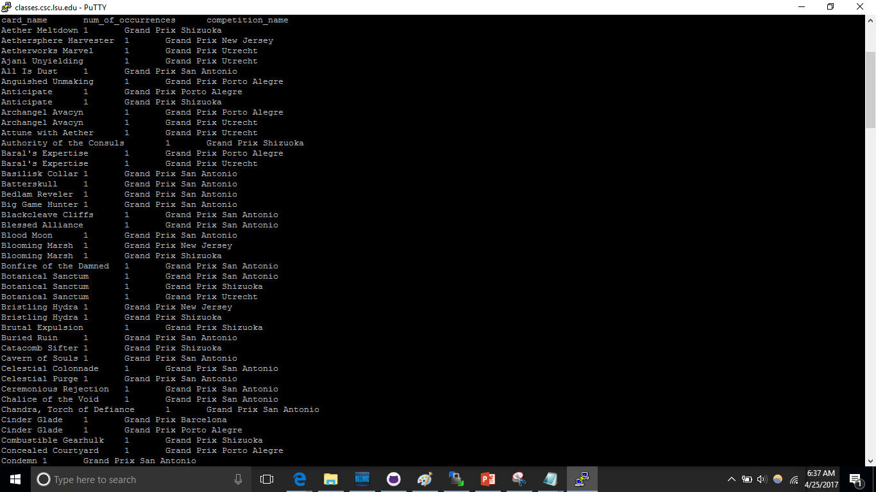
result

Slide 27
Percentage of decks with a given card
SELECT card_name, CONCAT(ROUND( (instances_of_card/total_num_of_decks)*100, 2),'%') AS percentage_of_decks
FROM (select COUNT(deck_name) as total_num_of_decks FROM (SELECT DISTINCT deck_name FROM card_usage) AS decks ) AS total,
(select re.card_name, COUNT(re.deck_name) as instances_of_card FROM card_representation as re, cards as c WHERE c.card_name = re.card_name and c.type NOT LIKE "%LAND%" GROUP BY card_name) AS num_of_decks_with_card

Slide 28
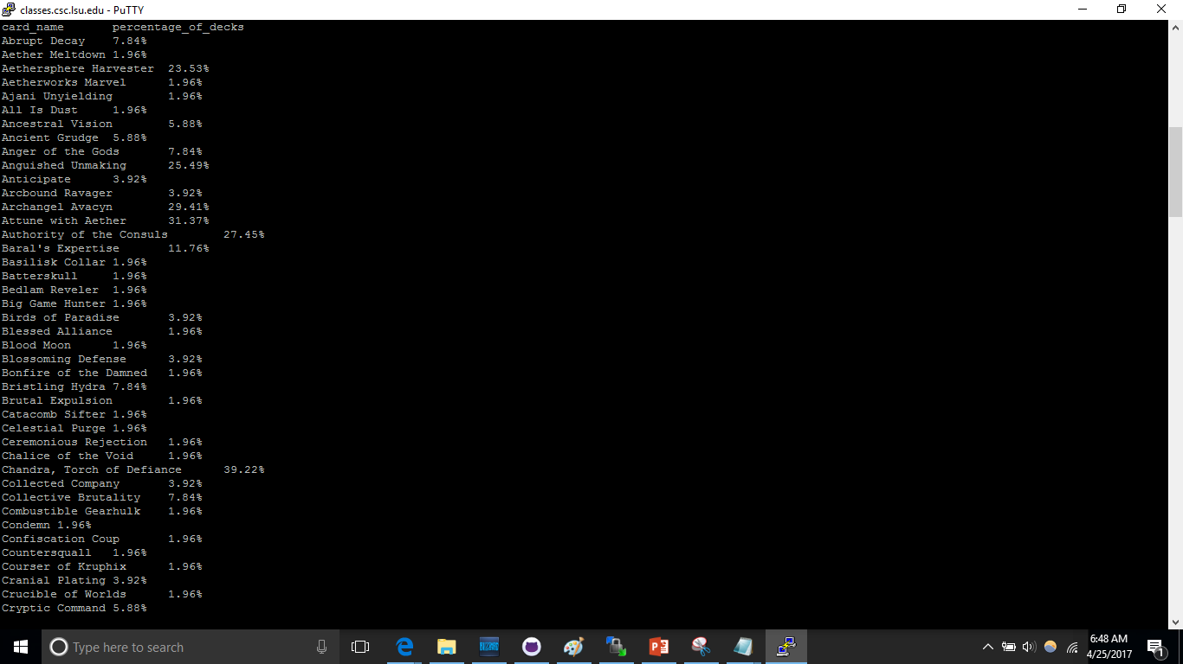
result

